Slide 1
Advertisement
Infographic

Slide 3
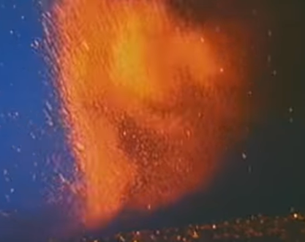
Poster

